Slide 1



Intensity-Based Alignment of Laser Devices
Track Tech: Dawson Burgess, Spencer Butler, Marissa Samayoa

Slide 2

Table of Contents
Objective
Background
Hansen Photonics
Laser Data
Value Proposition
Product Requirements
Budget
Discontinued Work
Conceptual Development
Testing and Results
Final Design
Demonstration
Conclusion and Recommendations

Slide 3
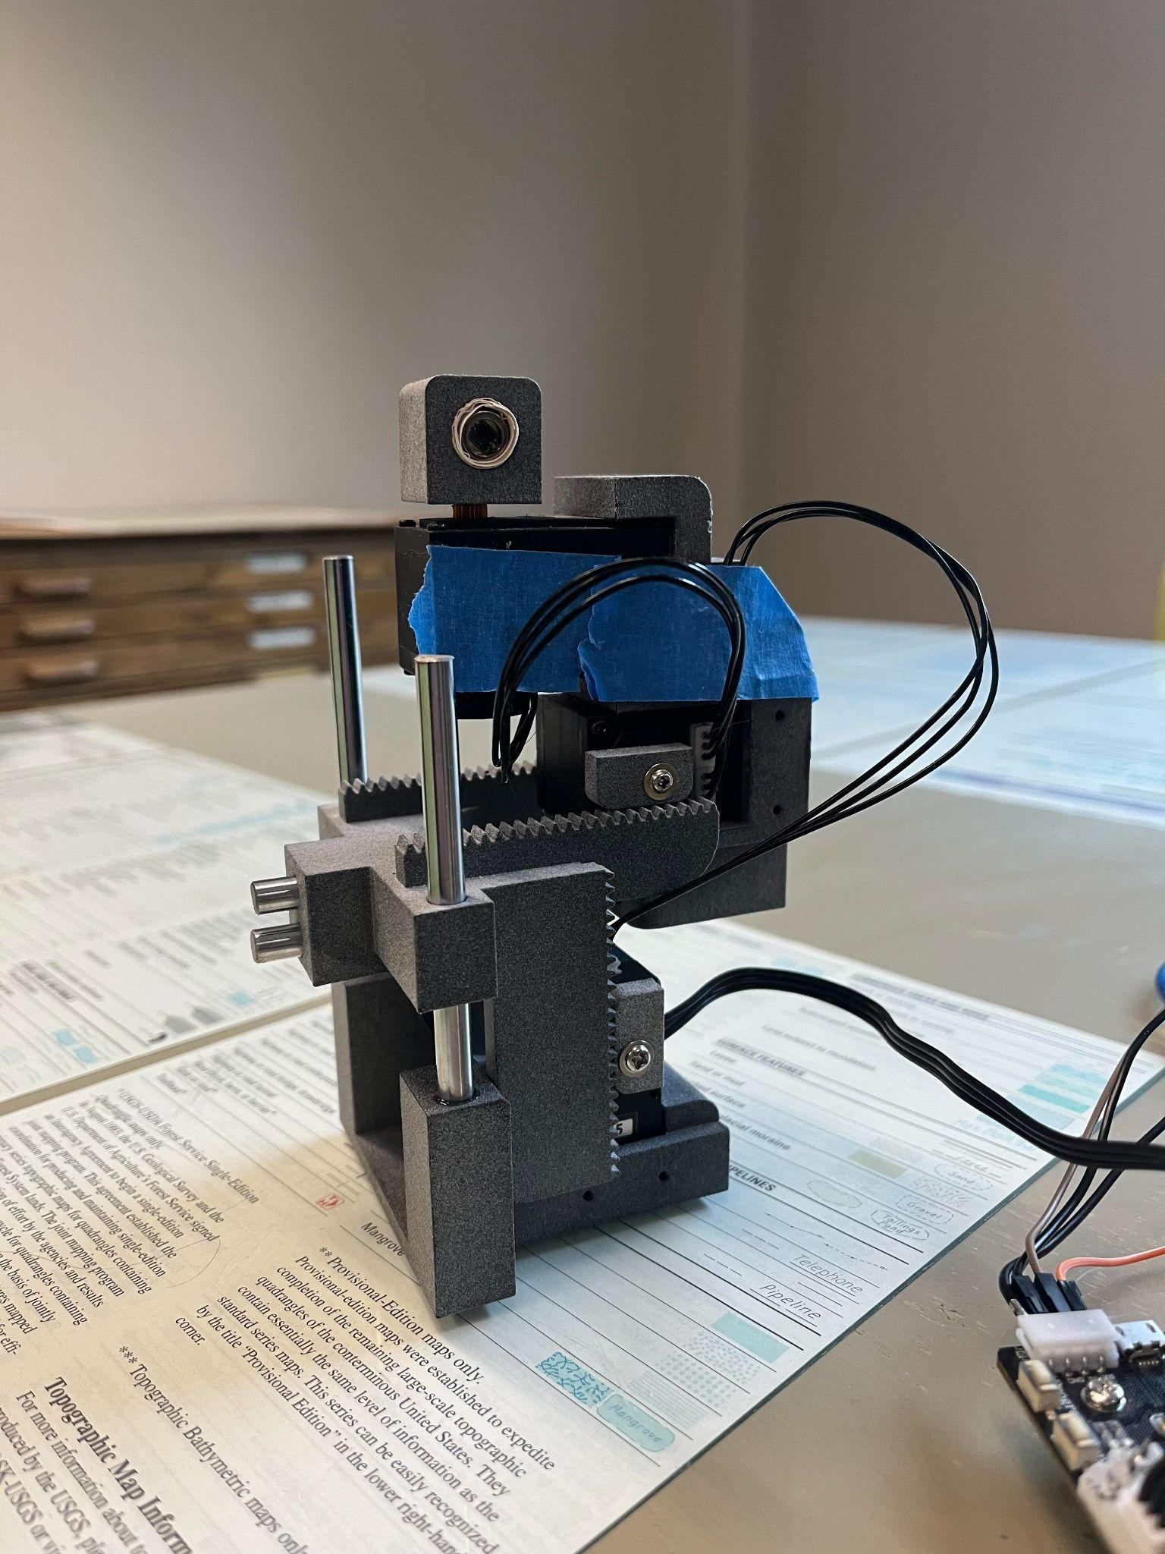



Objective
Our project aims to implement and test embedded software to drive a robotic arm for optical beam alignment between two devices.
The objective is to have the devices communicate with each other about their location using optical intensity (light based). The devices will then use that to focus a laser signal to each other and align to achieve maximum strength.

Slide 4
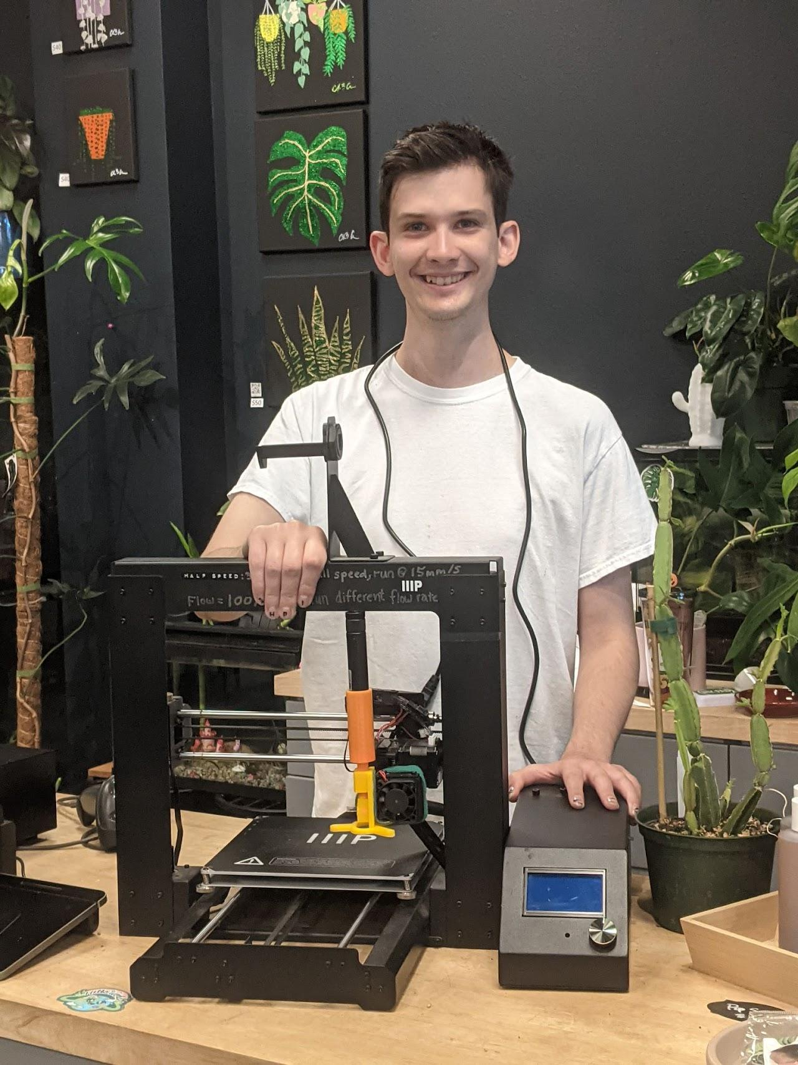
Background - Hansen Photonics
Hansen Photonics Incorporated is a small, family company located in Burien, Washington.
They contribute to the computer networking industry with patents that cover modular networking hardware devices and systems.
HPI works with universities, environmental science centers, and small businesses to help provide new, cutting-edge hardware solutions for everyone.

Slide 5
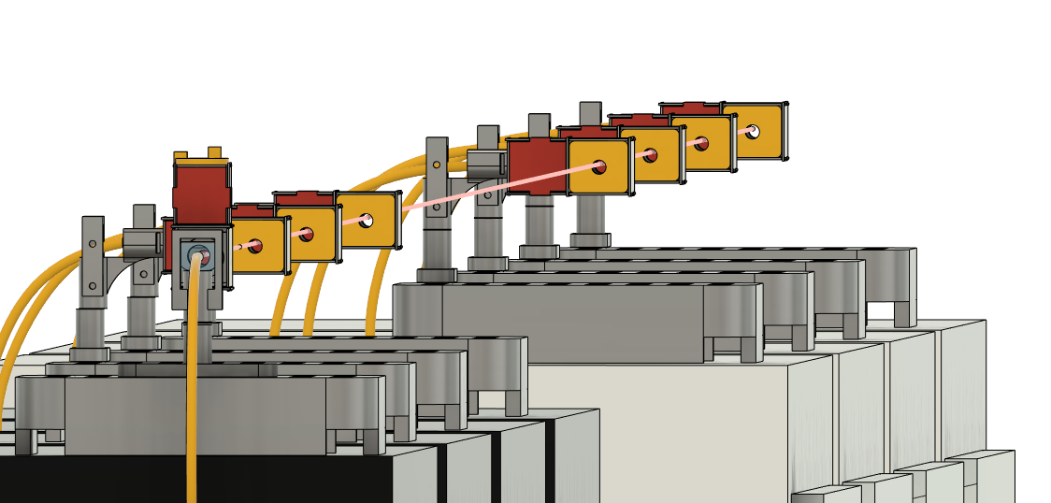
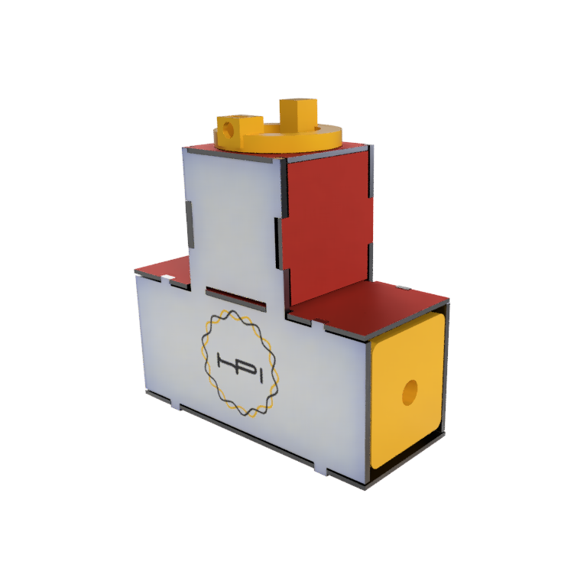
Background - Laser Data
Fiber and network cables are fast and secure, but often expensive, and require physical connections.
Wifi has no cables and can be fast, but struggles with security vulnerabilities and has a hard cap on transfer speeds.
Our technology will look to take the best of both implementations without their drawbacks.

Slide 6

Value Proposition
Optical transfer allows for far greater transfer capacity than using electricity.
It can be implemented in a cost effective, yet environmentally friendly way via lasers.
Laser data transfer requires very precise alignment between two devices, and often takes hours of labor to establish a single connection.
We will design software which utilizes light intensity that enables the devices to align and form a connection with a single button press.

Slide 7
Product Requirements
01
This alignment process shall work at a minimum distance of 6 feet.
02
After beginning the program, the alignment process shall be fully automatic.
03
The devices shall weigh fewer than 10 lbs each.
04
The program shall be written in a modular style.

Slide 8
Budget
$100 - EXPO poster
$10.38 - tsl2591 light sensor
$24.32 - GPS modules
$13.33 - accelerometers
$3.95 - male-female USB connector
$6.35 - white LEDs
—
Total: $158.33
$300: Given Budget
-$158.33: Spent
—
$141.67: Money Saved

Slide 9
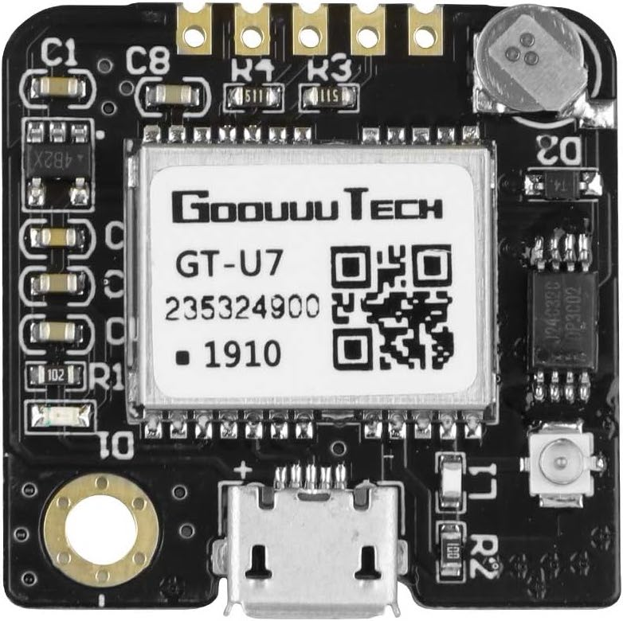
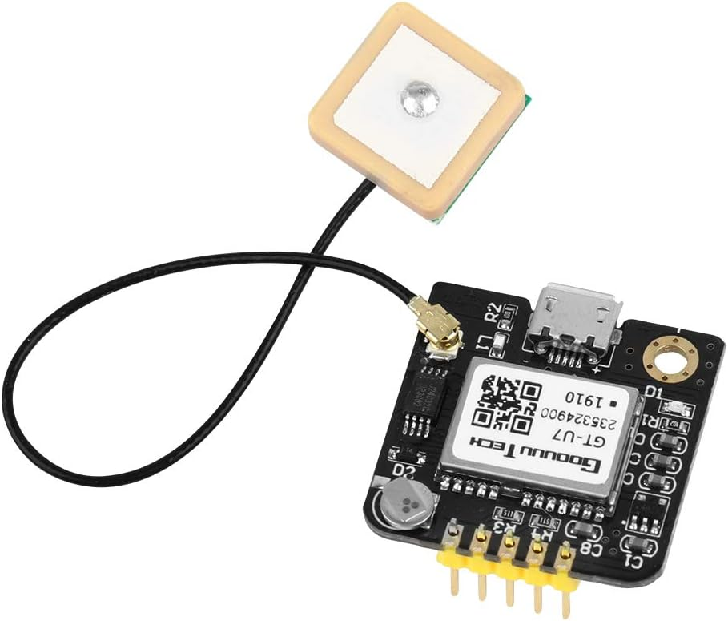
Discontinued Work
Last years work The previous team’s implementation was unsuitable for direct integration into the final product. However, adapted algorithms/techniques were considered in the new one.
GPS A GPS-based approach was attempted. Development proceeded to the point of measuring and directly comparing the measured positions of two receivers, at which point the viability could be properly evaluated. Inherent limitations of GPS, primarily the degree of precision available, made it unfeasible for this use case.

Slide 10
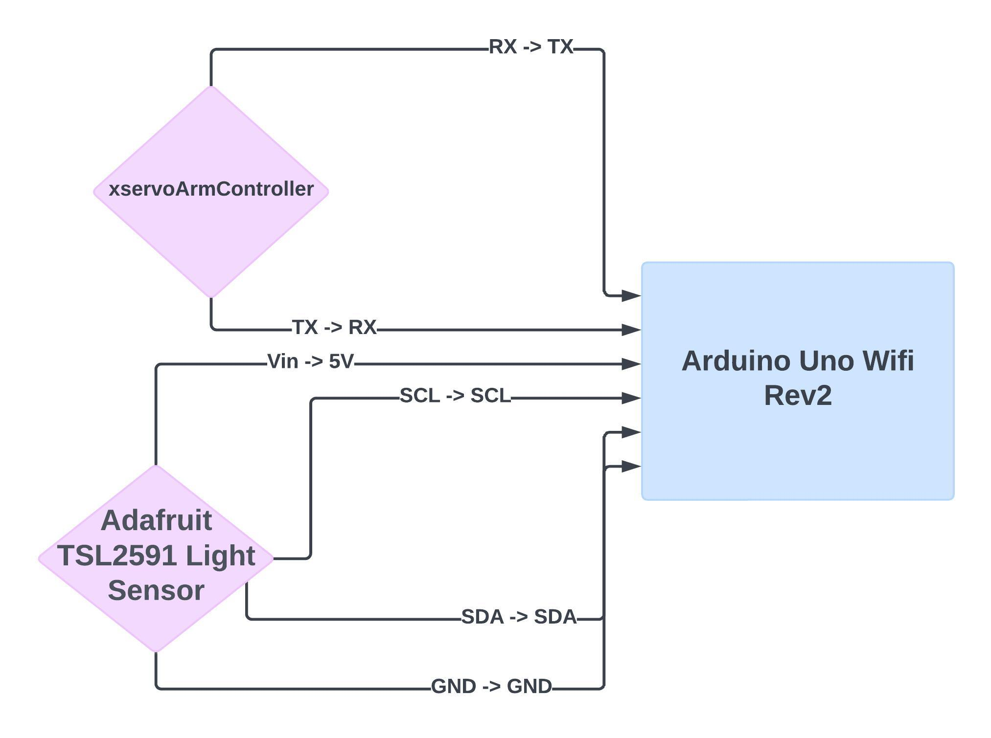
Conceptual Development

Slide 11
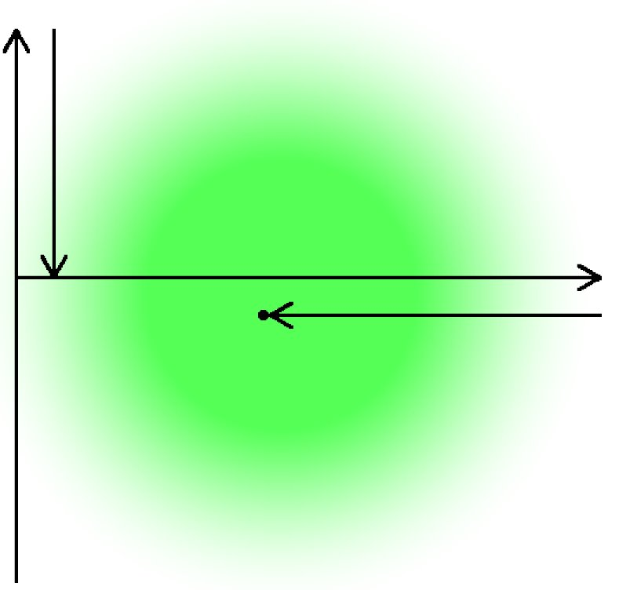
Conceptual Development
The new alignment approach is based around repeated optimization along individual axes, making use of a broad light source coaxial to the laser for initial alignment.
The first axis searched is the R axis, rotating about the vertical. Optimizing this axis finds the approximate direction towards the broad light source, and with it the laser.
The sensor is then reconfigured to low gain to facilitate alignment with the laser itself. In this stage, the robot alternates optimization of axes, searching for the brightest position along each axis to use as the initial position when searching along the next. This continues until the measured value passes a certain threshold.

Slide 12
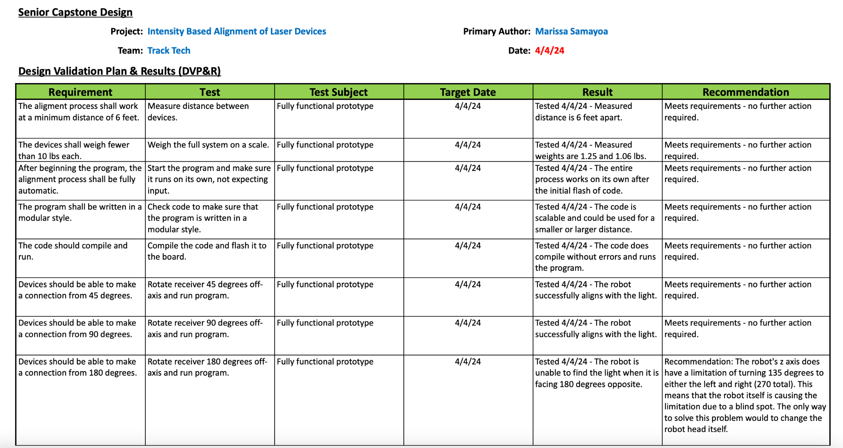
Testing and Results

Slide 13
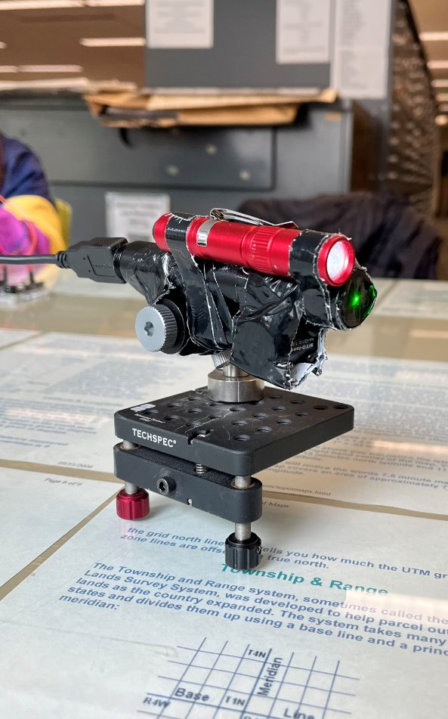
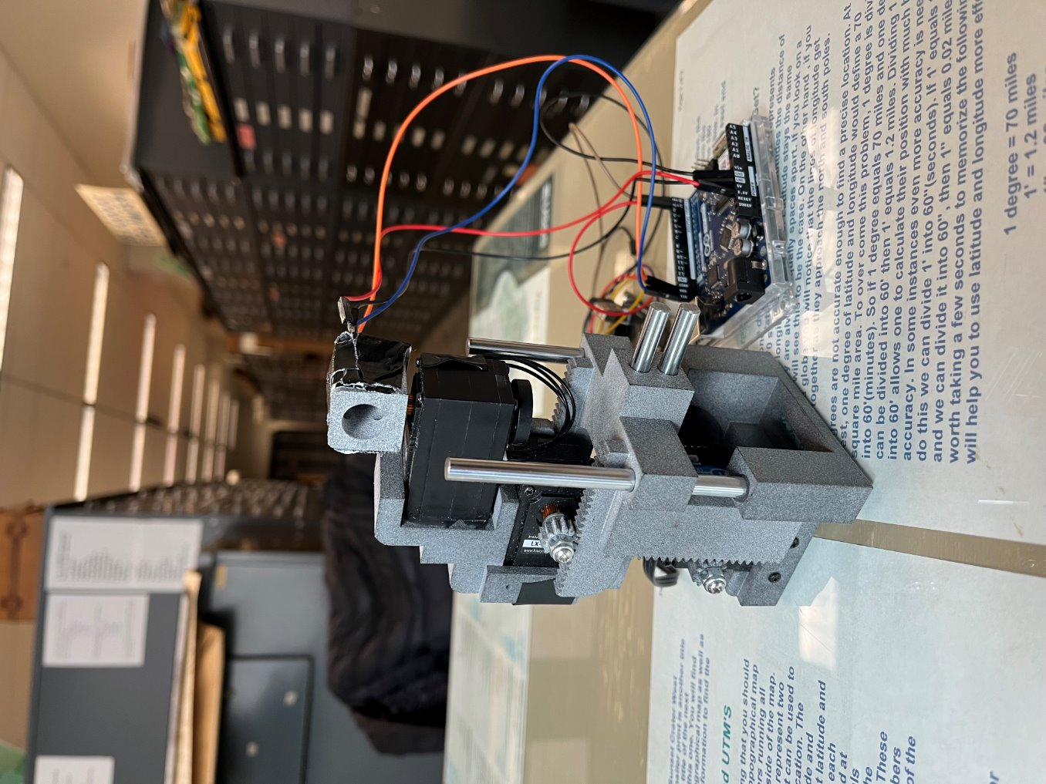
Final Design

Slide 14
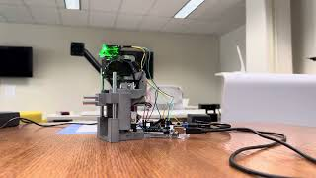
Video Demonstration

Slide 15
Conclusion and Recommendations
The alignment process created meets the desired requirements, aligning the laser to the receiver, while also being scalable.
However, it may take several minutes, and the receiver may stop when reaching the side of the laser rather than the center.
Further development could optimize the speed of the alignment or ensure that the receiver always reaches the exact center of the laser.

Slide 16
Thank you
Any Questions?

